Slide 1
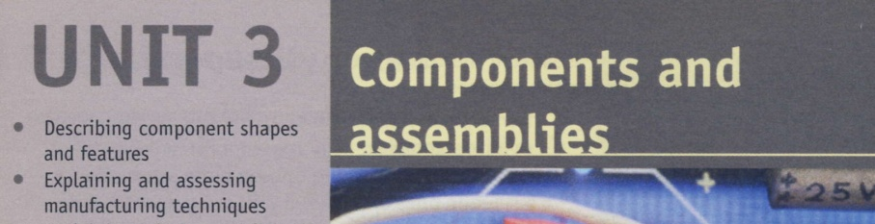
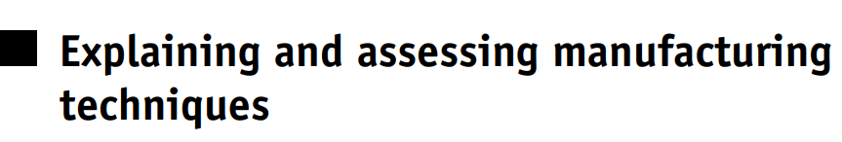
Notes:
Language note You will find the following vocabulary useful in this section. drill, mill, saw, shear, flame-cut, grind, cast, hammer guillotine, punch, hole-saw, (toothed) blade, abrasive wheel, cutting wheel, kerf Before you begin … Explain what is meant by manufacturing (= producing things in large numbers). You could look at related words, for example manufacturer, factory (British English) / plant (American English), production line, mass produce, mass production

Slide 2
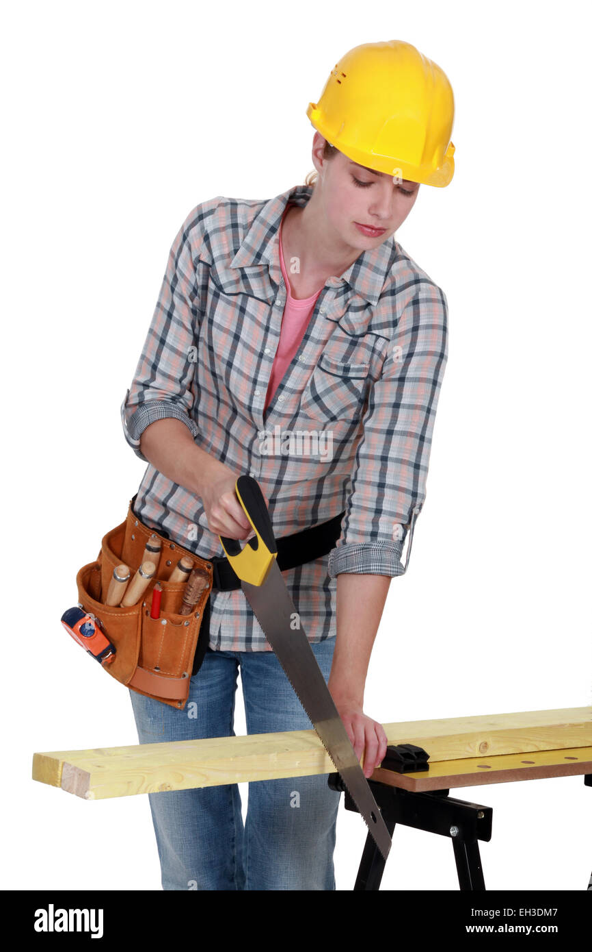
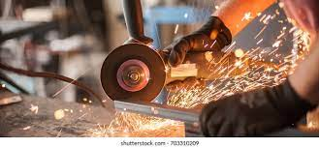
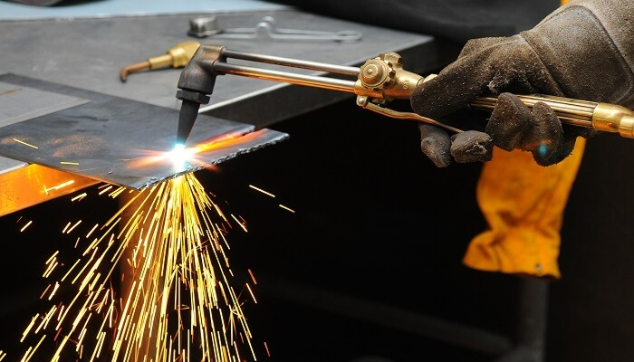

Slide 3
Sawing grinding flame cutting

Slide 4
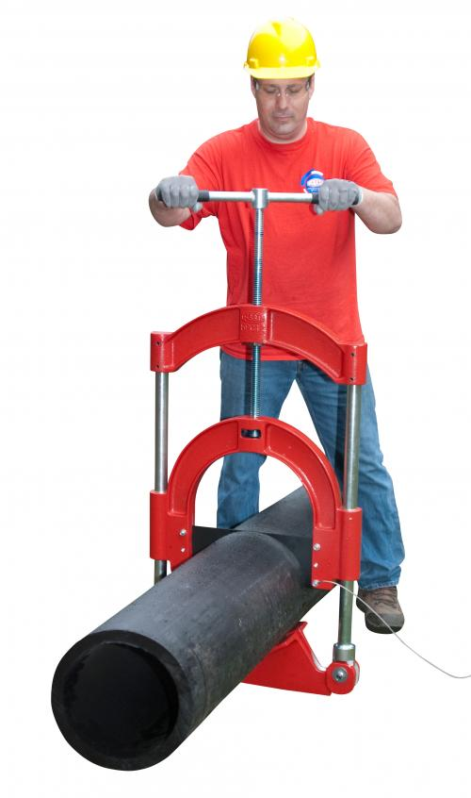
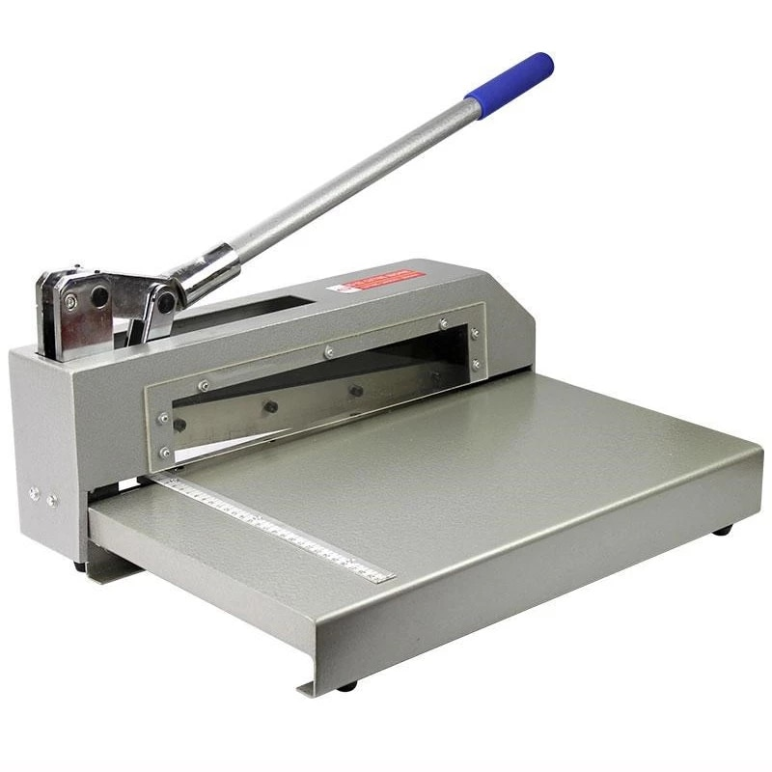
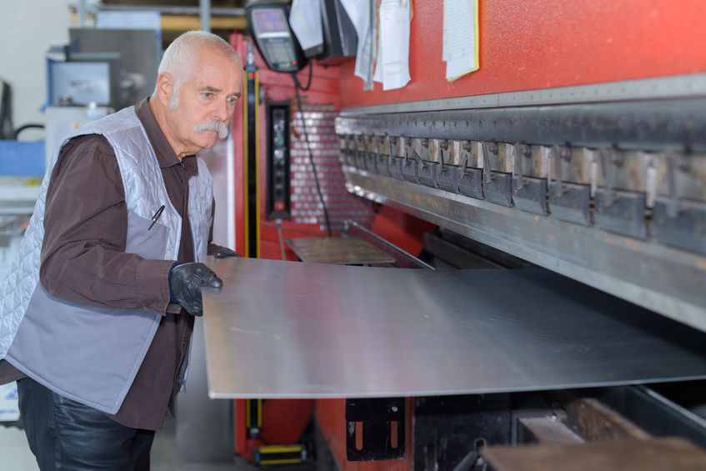

Slide 5
Guillotine Shearing press sheet metal

Slide 6
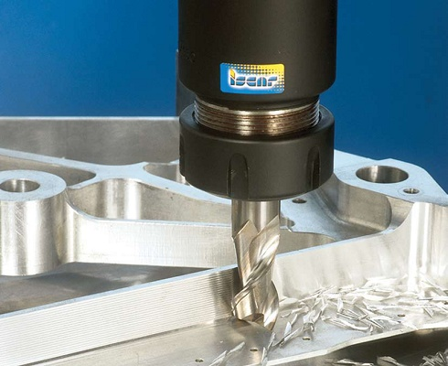
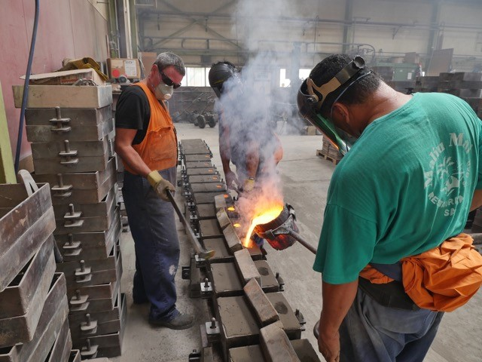
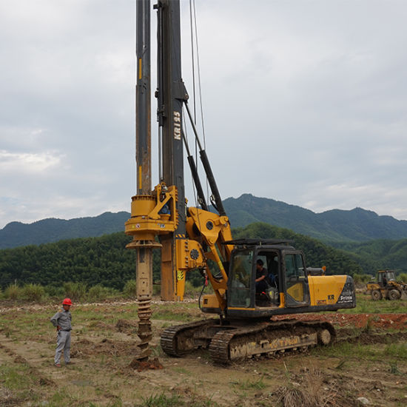

Slide 7
Drilling Milling casting

Slide 8
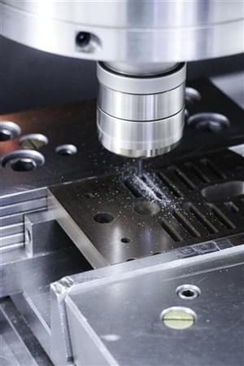
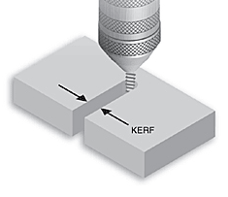

Slide 10
Punching Kerf

Slide 11
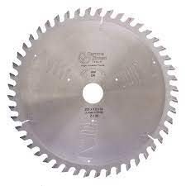
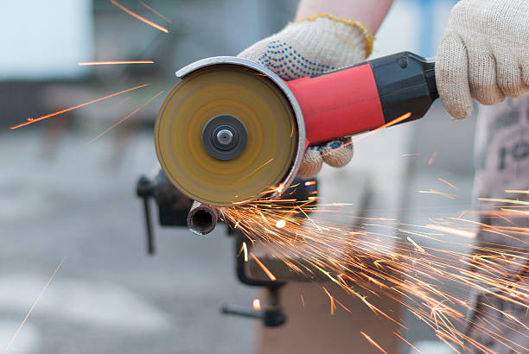
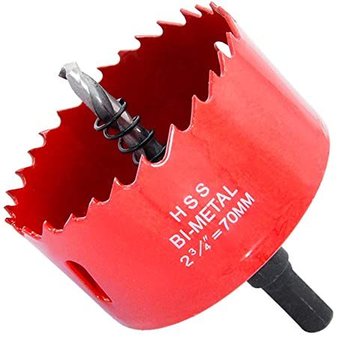

Slide 12
Toothed blade Abrassive wheel Hole-saw

Slide 13
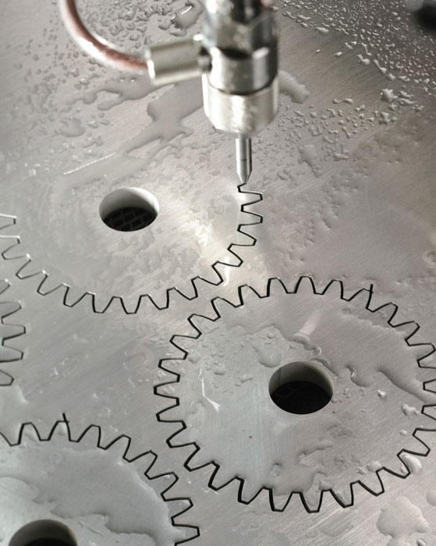
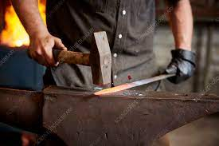
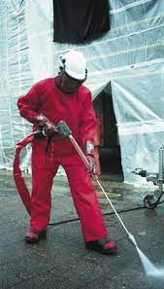

Slide 14
waterjet Hammering

Slide 15
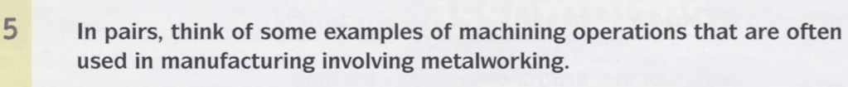
Language note to saw with a saw, to drill with a drill, to hammer with a hammer.
The concept of verbing (making verbs from nouns) is common in industry when describing the functions of highly specific tools and machines, for example to diamond drill (using a diamond drill)
.

Slide 16
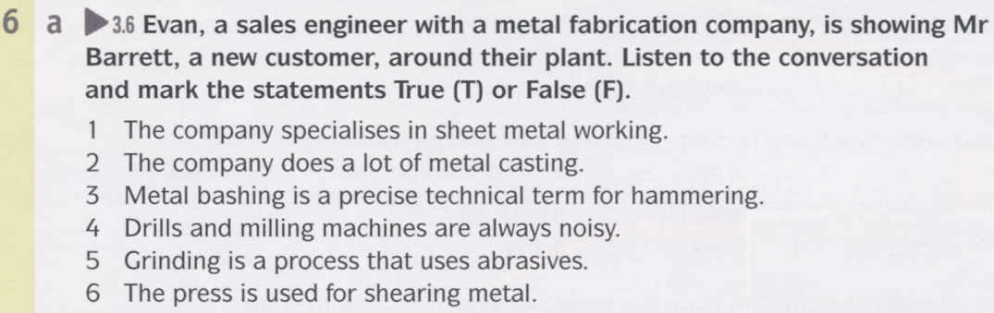

Notes:
Answers 1 T 2 F – casting is a different discipline 3 F – it’s a slang term 4 F – work involving abrasives is noisier 5 T 6 T

Slide 17
T
F
F
F
T
T
Notes:
Answers 1 T 2 F – casting is a different discipline 3 F – it’s a slang term 4 F – work involving abrasives is noisier 5 T 6 T

Slide 18
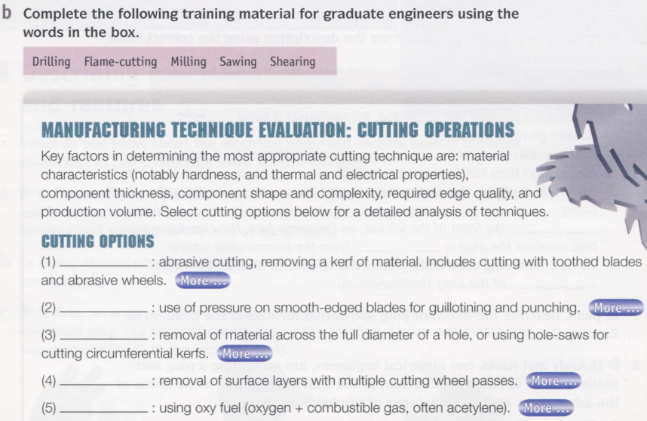
Notes:
Answers 1 Sawing
2 Shearing
3 Drilling
4 Milling
5 Flame-cutting

Slide 19
Sawing
Shearing
Drilling
Milling
Flame-cutting
Notes:
Answers 1 Sawing
2 Shearing
3 Drilling
4 Milling
5 Flame-cutting

Slide 20
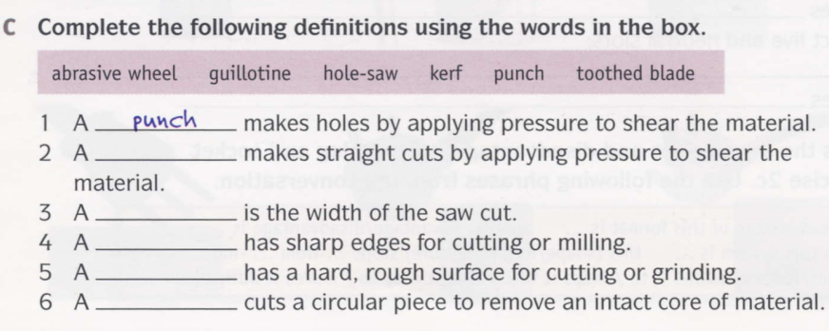
Notes:
Answers 2 guillotine
3 kerf
4 toothed blade
5 abrasive wheel
6 hole-saw

Slide 21
guillotine
kerf
toothed blade
abrasive wheel
hole-saw
Notes:
Answers 2 guillotine
3 kerf
4 toothed blade
5 abrasive wheel
6 hole-saw

Slide 22
the meaning of some of the terms in Exercise 6b in more detail. hardness = a material’s resistance to abrasion toughness = a material’s resistance to breaking when subjected to tension (stretching) or bending thermal properties = a material’s characteristics at different temperatures thermal stability = a material’s ability to behave consistently at different temperatures (important because cutting processes such as sawing and grinding generate heat, which can damage thermally sensitive materials) electrical properties = a material’s ability to conduct electricity and its behaviour when an electric current passes through it (important because some cutting processes use an electric arc, only suitable with materials that are effective electrical conductors – i.e. metals) edge quality = the degree of smoothness of the edge of a material after it has been cut (important because some techniques produce smoother cuts than others) production volume = the amount produced (usually by a factory) (important because some cutting techniques are relatively time-consuming, making them unsuitable for mass production) cutting wheel = an abrasive or toothed wheel designed to cut materials (note that milling machines use toothed metal cutting wheels to progressively shave thin layers of metal from the surfaces of components producing swarf = metal shavings produced by milling machines) grinding = using an abrasive wheel to grind away the surface, producing hot particles of molten metal due to heat from friction in the form of sparks combustible = can be burned

Slide 23
secondary operations: additional machining, such as polishing net-shaped parts: parts with accurately cut edges; often intricate shapes heat-affected zone: the area modified by high temperatures (resulting from the heat of cutting) mechanical stresses: physical forces such as shear forces when sawing or guillotining metal narrow kerf: narrow thickness of material removed during cutting; especially easy to do with waterjet cutting tightly nested: when several components are cut from the same piece of material the components can be placed close together, making better use of the material

Slide 24
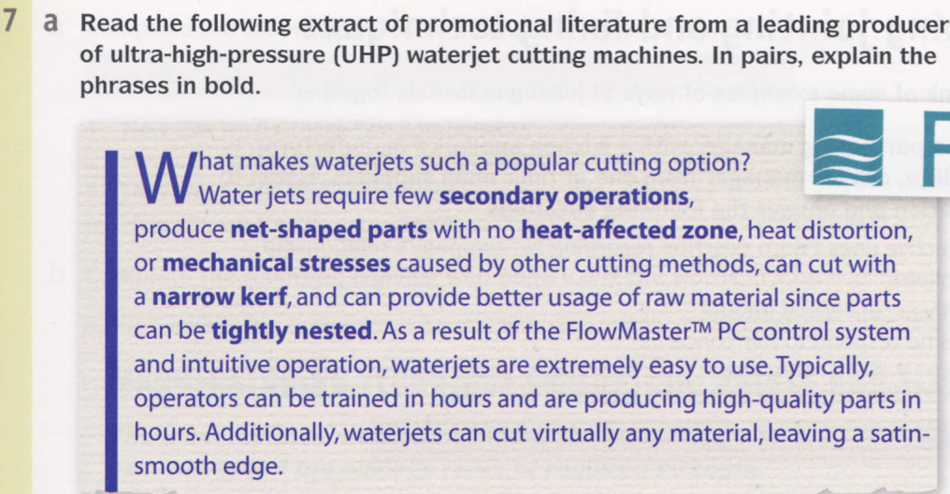
Notes:
Before you begin … Ask students to explain what is meant by high-pressure waterjet cutting (= cutting materials using extremely powerful jets of water) and heat distortion (= changes in the shape of a component, due to heating).

Slide 25
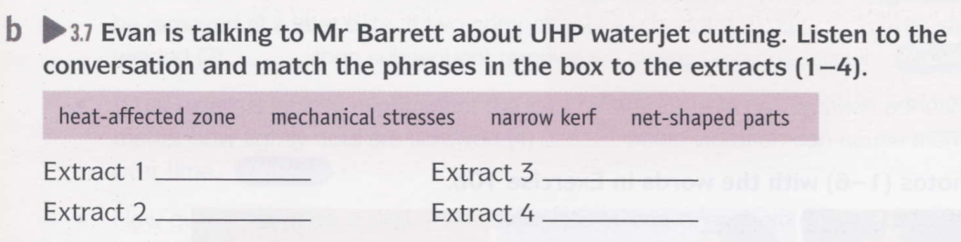
net-shaped parts
mechanical stresses
heat-affected zone
mechanical stresses
Notes:
Students listen and match the phrases to the extract. Ask students to explain what is meant by abrasive waterjet (= adding an abrasive powder to the water to increase its cutting power). You could ask students to suggest what sort of material the powder might be. For example, garnet is a type of rock widely used in abrasive materials. Garnet paper is also called sandpaper in everyday English.
1 net-shaped parts
2 heat-affected zone
3 mechanical stresses 4 mechanical stresses

Slide 26
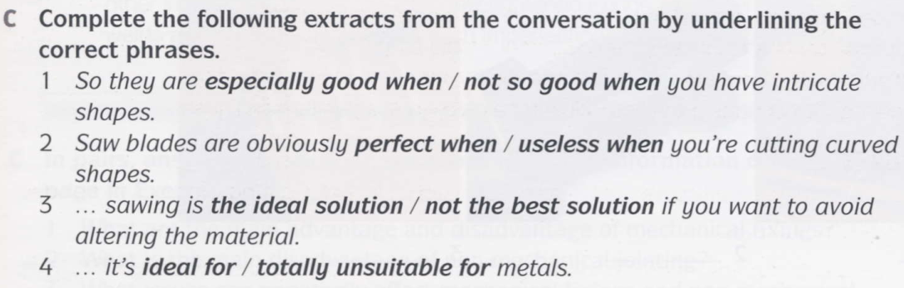
Notes:
1 especially good when
2 useless when
3 not the best solution
4 ideal for

Slide 27
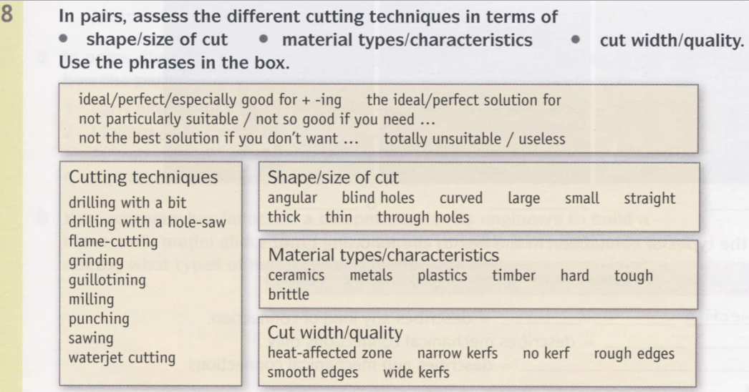

Slide 28
Drilling with a bit is good for cutting blind holes. Drilling with a hole-saw is ideal for cutting timber.
Flame-cutting is perfect for cutting metals. It’s useless for cutting ceramics.
Grinding is perfect for cutting wide kerfs. It’s totally unsuitable if you don’t want a heat-affected zone.
Guillotining is especially good for cutting thin materials. It’s not particularly suitable for cutting thick materials.
Milling is especially good for cutting metals. It’s totally unsuitable for cutting timber.
Punching is suitable for cutting through holes. It’s useless for cutting blind holes.
Sawing is ideal for cutting straight edges. It’s not so good if you need to cut curved edges.
Waterjet cutting is ideal if you need curved edges. It’s not so good for cutting very thick materials.

